Slide 1
Computer Networks
(컴퓨터 네트워크)
Text: Computer Networks and Internets, 6th ed.
By Douglas E. Comer
Dept. of Software Science, Dankook University

Slide 2

조 경 산 교수:
kscho@dankook.ac.kr (원격 강의 기간 연락처)

Slide 3
Topics Covered
How do computer networks and internets operate?
Internet trends, application
Data Communication Basics
Networks - LAN (Wired and Wireless)
Internetworking (TCP/IP)
Networking Tools - Wireshark

Slide 4
Grading Policy
Penalty for more than one being late/no-attendance
No credit for any missing regular Exams
All assignments are done individually
Final-exam : 40%
Mid-tem Exam : 40%
Assignments : 10%
Attendance : 10%

Slide 5
Course Goal
Understanding the basics of data communications
Understanding the technologies of networks (mainly LAN)
Understanding the basic operations and protocol of Internet

Slide 6
PPTs are from lecture slides of the following books.
Computer Networking A Top Down Approach, 7th Ed.
by Kurose & Ross, Pearson
Computer Networks and Internets, 6th Ed.
by Douglas E. Comer, Pearson

Slide 7
PART I
Introduction and Internet Applications

Slide 8


















A closer look at network structure:
network edge:
  hosts: clients and servers
  servers often in data centers
mobile network
global ISP
access networks, physical media: wired, wireless communication links
home
network
regional ISP
network core:
  interconnected routers
  network of networks
institutional
network
Introduction
1-<number>

Slide 9
Internet structure: network of networks
content provider networks (e.g., Google, Microsoft, Akamai) may run their own network, to bring services, content close to end users
…
…
access
net
access
net
access
net
access
net
access
net
IXP
access
net
access
net
ISP A
…
…
Content provider network
access
net
IXP
ISP B
access
net
ISP C
access
net
access
net
access
net
regional net
access
net
…
access
net
access
net
…
access
net
Introduction
1-<number>

Slide 10
Ping: connection, delays
C:\Users\K.Cho>ping www.google.com
Ping www.google.com [172.217.161.68] 32바이트 데이터 사용:
172.217.161.68의 응답: 바이트=32 시간=46ms TTL=53
172.217.161.68의 응답: 바이트=32 시간=46ms TTL=53
172.217.161.68의 응답: 바이트=32 시간=46ms TTL=53
172.217.161.68의 응답: 바이트=32 시간=47ms TTL=53
172.217.161.68에 대한 Ping 통계:
패킷: 보냄 = 4, 받음 = 4, 손실 = 0 (0% 손실),
왕복 시간(밀리초):
최소 = 46ms, 최대 = 47ms, 평균 = 46ms

Slide 11
“Real” Internet delays, routes
C:\Users\K. Cho>tracert www.google.com
최대 30홉 이상의
www.google.com [172.217.26.4](으)로 가는 경로 추적:
1 1 ms 1 ms 1 ms 192.168.200.254 ; 3 delay measurements
2 10 ms 9 ms 7 ms 10.141.0.1
3 9 ms 13 ms 10 ms 124.80.3.25
4 8 ms 8 ms 12 ms 117.123.2.225
5 9 ms 10 ms 9 ms 117.123.0.1
6 11 ms 14 ms 12 ms 192.168.64.25
7 11 ms 11 ms 11 ms 121.254.24.131
8 11 ms 11 ms 11 ms 121.254.24.138
9 26 ms 20 ms 21 ms 1.255.72.225
10 25 ms 25 ms 24 ms 39.115.132.74
11 * 20 ms 21 ms 10.222.6.53 ; * means no response
12 46 ms 42 ms 42 ms 72.14.215.199
13 44 ms 44 ms 46 ms 108.170.242.193
14 43 ms 43 ms 45 ms 66.249.95.155
15 41 ms 42 ms 40 ms nrt20s02-in-f4.1e100.net [172.217.26.4]
추적을 완료했습니다.

Slide 12
ipconfig
<Assignment>
Find out information on your computer using “ipconfig” with option “/all”.
Report physical address(물리적 주소) and IPv4 address(IPv4 주소) of your computer.

Slide 13


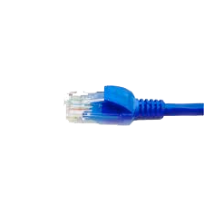

application
(www browser,
email client)
packet
analyzer
application
OS
packet
capture
(pcap)
Transport (TCP/UDP)
Network (IP)
Link (Ethernet)
Physical
copy of all Ethernet frames sent/received

Slide 14
Chapter 1
Introduction and
Overview

Slide 15
Networks, Interoperability, and Standards
Communication always involves at least two entities
  one that sends information and another that receives it
All entities in a network must agree on how information will be represented and communicated
  Communication agreements involve many details
An important issue is interoperability
  it refers to the ability of two entities to communicate
All communicating parties agree on details and follow the same set of rules, an exact set of specifications
Communication protocol, network protocol, or simply protocol to refer to a specification for network communication

Slide 16
Open Vs. Closed Networking
Closed networks
– Each vendor designs/ builds their own
– Given technology owned by vendor
– Vendor may license technology to other groups
Open networks
– Competitive approach
– Multiple groups collaborate to define a technology
– To insure interoperability, specifications written in
standards documents that are available to everyone
– Companies build products according to standards

Slide 17
Standards And Standardization
Why Standardize?
Networking supports communication among multiple entities
Agreement needed to make communication correct, efficient, and meaningful Computer
Which Organizations Issue Standards?
IEEE (Institute of Electrical and Electronics Engineers)
IETF (Internet Engineering Task Force)
ITU (International Telecommunications Union)
ISO (International Organization for Standardization)
W3C (World Wide Web Consortium)
and many others

Slide 18
Protocol
Each protocol specifies how to handle one aspect of communication
A protocol can specify
– Low-level details such as voltage and frequency
– High-level details such as format visible to a user
Many individual communication protocol standards exist
Set of protocols designed to work together is known as a suite
– Example: TCP/ IP Internet protocol suite

Slide 19
Two Key properties of Protocols
Syntax
– Format of each message
– Representation of data items
– Encoding of bits in electromagnetic signals
Semantics
– Meaning of each message
– Procedures used to exchange messages
– Actions to take when an error occurs

Slide 20
Protocol Layering
Needed because communication is complex
Intended primarily for protocol designers
Divides communication into intellectually manageable
pieces
Provides a conceptual framework that can help us
understand protocols
Ideally, layering is invisible once protocols have been
designed
Notes:
– Layering gives a guideline, not a rigid framework
– Optimizations may violate strict layering

Slide 21
Two Layering Models
The fundamental abstraction used to collect protocols into a unified whole is known as a layering model
All aspects of a communication problem can be partitioned into pieces that work together
  each piece is known as a layer
Internet protocols use a 5-layer reference model
ISO and the ITU defined a 7-layer model Computer

Slide 22
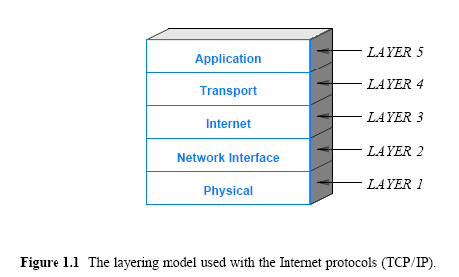
Internet Reference Model

Slide 23
Protocol Suites and Layering Models
Physical Layer (Layer 1)
- Underlying transmission media
- Electromagnetic energy and its use
- Representation of information in signals
- Electrical properties such as radio frequencies and voltage
- Associated hardware
Network Interface Layer (Layer 2)
- Communication between a computer and network hardware
- Also called data link or MAC layer
- Mechanisms for gaining access to shared media
- Hardware (MAC) addressing
- Packet (frame) formats
- Packet (frame) types and demultiplexing
- Error detection

Slide 24
Protocol Suites and Layering Models
Internet Layer (Layer 3)
- Communication between a pair of computers across the Internet
- Internet packet format (datagram)
- Internet addressing model and address assignment
- Forwarding of Internet packets
- Dividing an Internet packet into smaller packets for transmission
- Error detection and reporting
Transport Layer (Layer 4)
- Communication between a pair of applications
- Demultiplexing among multiple destinations on a computer
- Reliable delivery and retransmission
- Mechanisms to control data rate and avoid congestion

Slide 25
Protocol Suites and Layering Models
Application Layer (Layer 5)
- Format and representation of data and messages
- Procedures applications follow to
    Transfer data
    Handle errors or unexpected conditions
- Meaning of messages exchanged
- Internet infrastructure such as routing and DNS

Slide 26
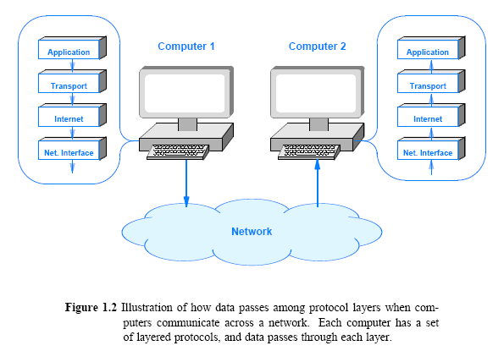
How Data Passes Through Layers

Slide 27
1.8 Headers and Layers
Each layer of protocol software performs computations
  that insure the messages arrive as expected
To perform such computation, protocol software on the two machines must exchange information
  each layer on the sender prepends extra information onto the packet
  the corresponding protocol layer on the receiver removes and uses the extra information
Additional information added by a protocol is known as a header
Headers are added by protocol software on the sending computer
If we observe a packet traversing the network, the headers will appear in the order that Figure 1.3 illustrates
Although the figure shows headers as the same size
  in practice headers are not of uniform size
  and a physical layer header is optional

Slide 28
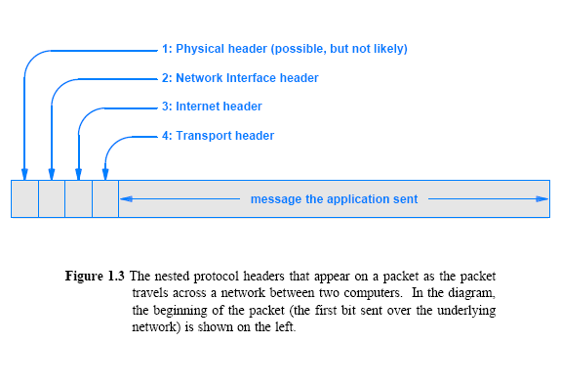
Headers and Layers

Slide 29
Complications of Layering
Layering diagrams are abstract and simplistic
Details and exceptions complicate practical systems
Some examples
– Cross-layer communication
– Multiple protocols per layer
– Layering in an Internet

Slide 30
ISO and the OSI Seven-Layer Reference Model
At the same time the Internet protocols were being developed, two large standards bodies jointly formed an alternative reference model
  They also created a set of internetworking protocols
These organizations are:
  International Standardization Organization (ISO)
  International Telecommunications Union,Telecommunication (ITU-T)
    The ITU was known as the Consultative Committee for International Telephone and Telegraph (CCITT)
The ISO layering model is known as the Open Systems Interconnection (OSI) Seven-Layer Reference Model
Figure illustrates the seven layers in the model

Slide 31
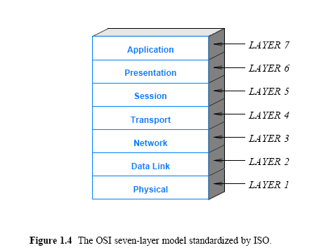
ISO and the OSI Seven-Layer Reference Model

Slide 32
ISO 7-Layer Reference Model
Prescriptive model formed before protocols were devised
Created by committee vote
Model was defined when data networks connected dumb terminals to large mainframes
Two layers now superfluous
Session layer
– Handled details of login and control of send/ receive
– Provided opportunity for billing and accounting
Presentation layer
– Defined data representation
– Primary intention was to map character sets

Slide 33
Internet Applications and
Network Programming

Slide 34
General Principle
The Internet does not provide services. Instead, the Internet only provides communication, and application programs provide all services.
Consequence
– Every Internet communication, including voice and video teleconferencing, involves communication among application programs
.

Slide 35
Introduction
The Internet offers users a rich diversity of services
  none of the services is part of the underlying communication infrastructure
Internet provides a general purpose mechanism on which
  all services are built
  and individual services are supplied by application programs that run on computers attached to the Internet

Slide 36
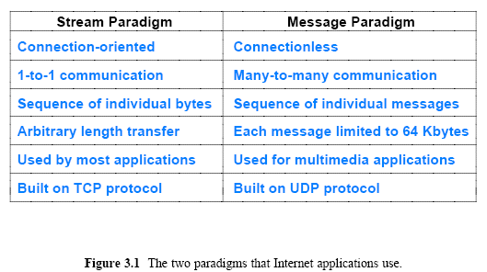
Two Basic Internet Communication Paradigms
The Internet supports two basic communication paradigms:
  Stream Transport in the Internet
  Message Transport in the Internet
Figure 3.1 summarizes the differences

Slide 37
Stream Transport in the Internet
Stream denotes a paradigm in which a sequence of bytes flows from one application program to another
The network accepts input from either application, and delivers the data to the other application – data sent between two applications (connection-oriented) and bidirectional (one stream in each direction)
The stream mechanism transfers a sequence of bytes without attaching meaning to the bytes and without inserting boundaries
A sending application can choose to generate one byte at a time, or can generate blocks of bytes
The network chooses the number of bytes to deliver at any time
  the network can choose to combine smaller blocks into one large block or can divide a large block into smaller blocks

Slide 38
Message Transport in the Internet
In a message paradigm, the network accepts and delivers messages (connectionless)
Each message delivered to a receiver corresponds to a message that was transmitted by a sender
  the network never delivers part of a message, nor does it join multiple messages together
The message paradigm allows delivery in different forms:
  Unicast
    a message can be sent from an application on one computer directly to an application on another, 1-to-1
  Multicast
    a message can be multicast to some of the computers on a network, 1-to-many
  Broadcast
    a message can be broadcast to all computers on a given network, 1-to-all

Slide 39
Message Transport in the Internet
Message service does not make any guarantees
So messages may be
  Lost (i.e., never delivered)
  Duplicated (more than one copy arrives)
  Delivered out-of-order
A programmer who uses the message paradigm must insure that the application operates correctly
  even if packets are lost or reordered
Programmers tend to use the stream service except in special situations
Thus, we will focus on the stream paradigm

Slide 40
Identifying Messages In a Stream
Possibilities
– Send exactly one message followed by end of file (EOF)
– Send multiple messages with an integer length before each message
– Send multiple messages with a termination character (or sequence) following each message
Notes
– Any technique can be used as long as both sides agree
– If sending a multi-byte length value or multi-byte termination sequence, remember that the application may need multiple calls receive all bytes

Slide 41
Quiz..
Although it delivers all bytes in sequence, ( ) does not guarantee that the chunks of bytes passed to a receiving application correspond to the chunks of bytes transferred by the sending application.
Although it preserves boundaries, ( ) allows messages to be lost, duplicated, or delivered outof- order; neither the sender nor receiver is informed when such errors occur.

Slide 42
The Client-Server Model of Interaction
how can a pair of applications that run on two independent computers coordinate to guarantee that they request a connection at the same time?
The answer lies in a form of interaction known as the client-server model
  A server starts first and awaits contact
  A client starts second and initiates the connection
Application programs known as clients and servers handle all services in the Internet
Confusion exists between scientific and marketing terminology
- Scientific: a client and a server are each programs
- Marketing: a server is a powerful computer

Slide 43
Characteristics of Clients and Servers
A client software:
  Is an arbitrary application program that becomes a client temporarily when remote access is needed, but also performs other computation
  Is invoked directly by a user, and executes only for one session
  Runs locally on a user's personal computer
  Actively initiates contact with a server
  Can access multiple services as needed, but usually contacts one remote server at a time
  Does not require especially powerful computer hardware

Slide 44
Characteristics of Clients and Servers
A server software:
  Is a special-purpose, privileged program
  Is dedicated to providing one service that can handle multiple remote clients at the same time
  Is invoked automatically when a system boots, and continues to execute through many sessions
  Runs on a large, powerful computer
  Waits passively for contact from arbitrary remote clients
  Accepts contact from arbitrary clients, but offers a single service
  Requires powerful hardware and a sophisticated operating system (OS)

Slide 45
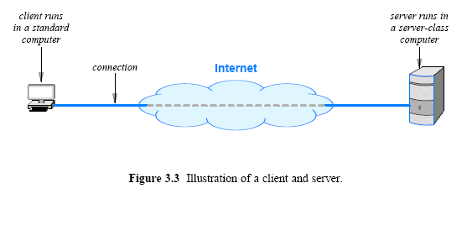
Server Programs and Server-Class Computers

Slide 46
Requests, Responses, and Direction of Data Flow
Client and server?
Which side initiates contact?
Once contact has been established, two-way communication is possible (i.e., data can flow from a client to a server or from a server to a client)
In some cases, a client sends a series of requests and the server issues a series of responses (e.g., a database client might allow a user to look up more than one item at a time)

Slide 47
Server Identification and Demultiplexing
How does a client identify a server?
The Internet protocols divide identification into two pieces:
  An identifier for the computer on which a server runs
  An identifier for a service on the computer
Identifying a computer?
  Each computer in the Internet is assigned a unique 32-bit identifier known as an Internet Protocol address (IP address)
  A client must specify the server’s IP address
  To make server identification easy for humans, each computer is also assigned a name, and the Domain Name System (DNS)
    described in Chapter 4 is used to translate a name into an address
  Thus, a user specifies a name such as www.cisco.com rather than an integer address

Slide 48
Server Identification and Demultiplexing
Identifying a service?
  Each service available in the Internet is assigned a unique 16-bit identifier known as a protocol port number (or port number)
    Examples, email → port number 25, and the web → port number 80
  When a server begins execution
    it registers with its local OS by specifying the port number for its service
  When a client contacts a remote server to request service
    the request contains a port number
  When a request arrives at a server
    software on the server uses the port number in the request to determine which application on the server computer should handle the request
Figure summarizes the basic steps

Slide 49
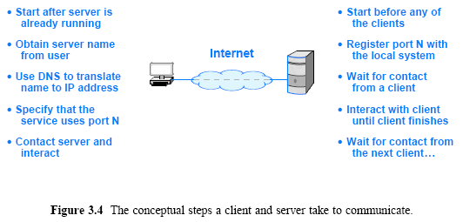
Server Identification and Demultiplexing

Slide 50
Broadcast
  Sender broadcasts message and all stations receive it
  Does not scale well (becomes inefficient)
  Difficult to restrict data access
Peer-To-Peer Interaction
  Designed to avoid central server bottleneck
  Data divided among N computers
  Each computer acts as a server for its data and as a client for other data
  Given computer receives 1 / N of the traffic

Slide 51
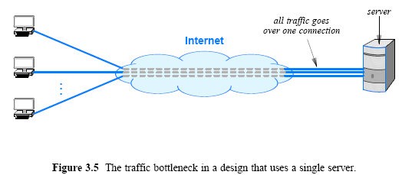
Peer-to-Peer Interactions
If a single server provides a given service
  the network connection between the server and the Internet can become a bottleneck
Figure illustrates the architecture

Slide 52
Peer-to-Peer Interactions
Can Internet services be provided without creating a central bottleneck?
  One way to avoid a bottleneck forms the basis of file sharing known as a peer-to-peer (P2P) architecture
The scheme avoids placing data on a central server
  data is distributed equally among a set of N servers
  and each client request is sent to the appropriate server
  a given server only provides 1/N of the data
Server software can run on the same computers as clients
Figure 3.6 illustrates the architecture

Slide 53
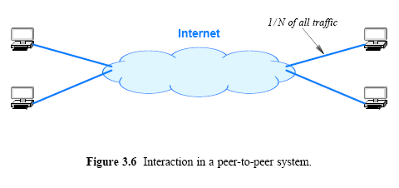
Peer-to-Peer Interactions

Slide 54
Network Programming
General term that refers to the creation of client and serverapplications that communicate over a network
The interface an application uses to specify communication is known as an Application Program Interface (API)
  Set of functions
  Include control as well as data transfer functions
Details of an API depend on the OS
One particular API has emerged as the de facto standard for software that communicates over the Internet
  known as the socket API, and commonly abbreviated sockets
The socket API is available for many OS
  such as Microsoft's Windows systems
  as well as various UNIX systems, including Linux

Slide 55
Sockets, Descriptors, and Network I/O
Because it was originally developed as part of the UNIX OS, the socket API is integrated with I/O
When an application creates a socket to use for Internet
  OS returns a small integer descriptor that identifies the socket
The application then passes the descriptor as an argument
  when it calls functions to perform an operation on the socket (e.g., to transfer data across the network or to receive data)
In many OS, socket descriptors are integrated with other I/O descriptors
  as a result, an application can use the read and write operations for socket I/O or I/O to a file

Slide 56
